Slide 1
Automating Ransomware Remediation with the VMware Carbon Black Cloud SDK
Alex Van Brunt, Emanuela Mitreva
Developer Relations, SBU
CODE 2782
#vmworld #code2782

Slide 2
Required Disclaimer for All Presentations
This presentation may contain product features or functionality that are currently under development.
This overview of new technology represents no commitment from VMware to deliver these features in any generally available product.
Features are subject to change, and must not be included in contracts, purchase orders, or sales agreements of any kind.
Technical feasibility and market demand will affect final delivery.
Pricing and packaging for any new features/functionality/technology discussed or presented, have not been determined.
Notes:
Use this as a template

Slide 3
Agenda
Ransomware Today
VMware Carbon Black
VMware Carbon Black Cloud Python SDK Demo

Slide 4
Ransomware Today

Slide 5
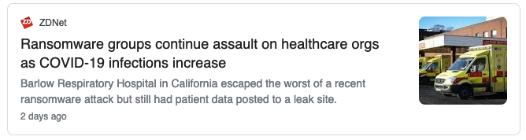
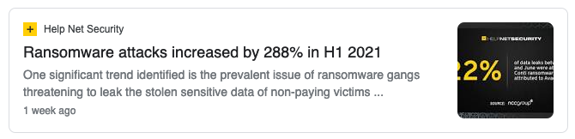
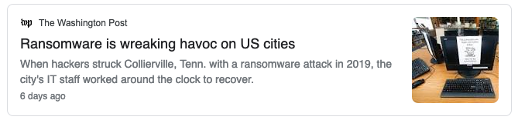
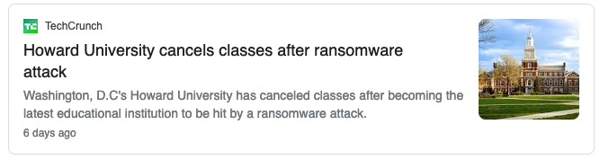
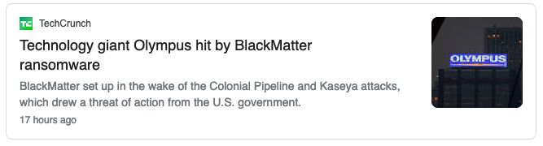
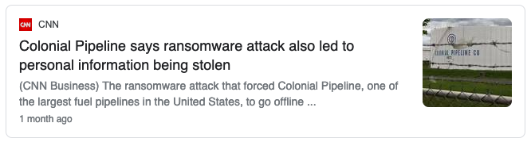
Latest Ransomware News

Slide 6
Ransomware Quote
Considered a low-dollar, online nuisance crime only a few short years ago, ransomware has exploded into a multi-billion-dollar global racket that threatens the delivery of the very services so critical to helping us collectively get through the COVID pandemic. To put it simply, we are on the cusp of a global pandemic of a different variety, driven by greed, an avoidably vulnerable digital ecosystem, and an ever-widening criminal enterprise”
Christopher Krebs
Notes:
https://homeland.house.gov/imo/media/doc/2021-05-05-CIPI-HRG-Testimony-Krebs.pdf Director of the Cybersecurity and Infrastructure Security Agency in the United States Department of Homeland Security Before the Committee on Homeland Security Subcommittee on Cybersecurity, Infrastructure Protection, & Innovation U.S. House of Representatives On Responding to Ransomware: Exploring Policy Solutions to a Cybersecurity Crisis

Slide 7
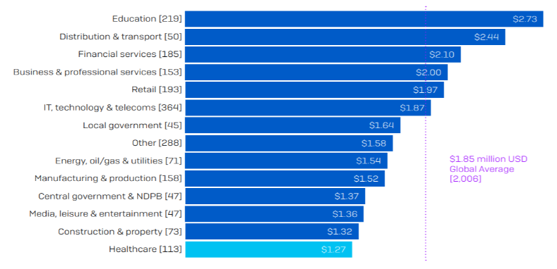
Average Bill for rectifying a ransomware attack
https://www.hhs.gov/sites/default/files/ransomware-trends-2021.pdf
Notes:
considering downtime, people time, device cost, network cost, lost opportunity, ransom paid, etc.

Slide 8
VMware Carbon Black

Slide 9
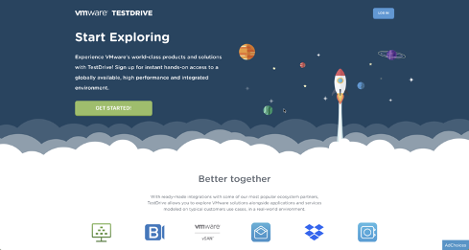
VMware Carbon Black Cloud Malware Lab
https://kb.vmtestdrive.com/hc/en-us/articles/4404323100187-VMware-Carbon-Black-Cloud-Malware-Lab
This walkthrough will enable you to get hands on with Carbon Black Cloud. The Malware Lab contains actual attacks that you can run live in a test environment to see how prevention and visibility work in the Carbon Black Cloud solution suite.

Slide 10
Policy Configuration as the First Line of Defense
Endpoint Standard Policy Tuning: Good, Better, Best
Endpoint Standard: How To Enable Enhanced Ransomware Protection
Threat Research Docs – Tau Tins
https://carbonblack.vmware.com/resource/endpoint-standard-policy-tuning-good-better-best
https://community.carbonblack.com/t5/Knowledge-Base/Endpoint-Standard-How-To-Enable-Enhanced-Ransomware-Protection/ta-p/102853
https://community.carbonblack.com/t5/Threat-Research/ct-p/threat-research

Slide 11
Cyber Threat Quote
“People always make the best exploits. I’ve never found it hard to hack most people. If you listen to them, watch them, their vulnerabilities are like a neon sign screwed into their heads.”
Elliot Alderson, Mr. Robot

Slide 12
Demo
VMware Carbon Black Cloud
Python SDK Demo

Slide 13

Please take your survey.

Slide 14
Thank you!

